Slide 1
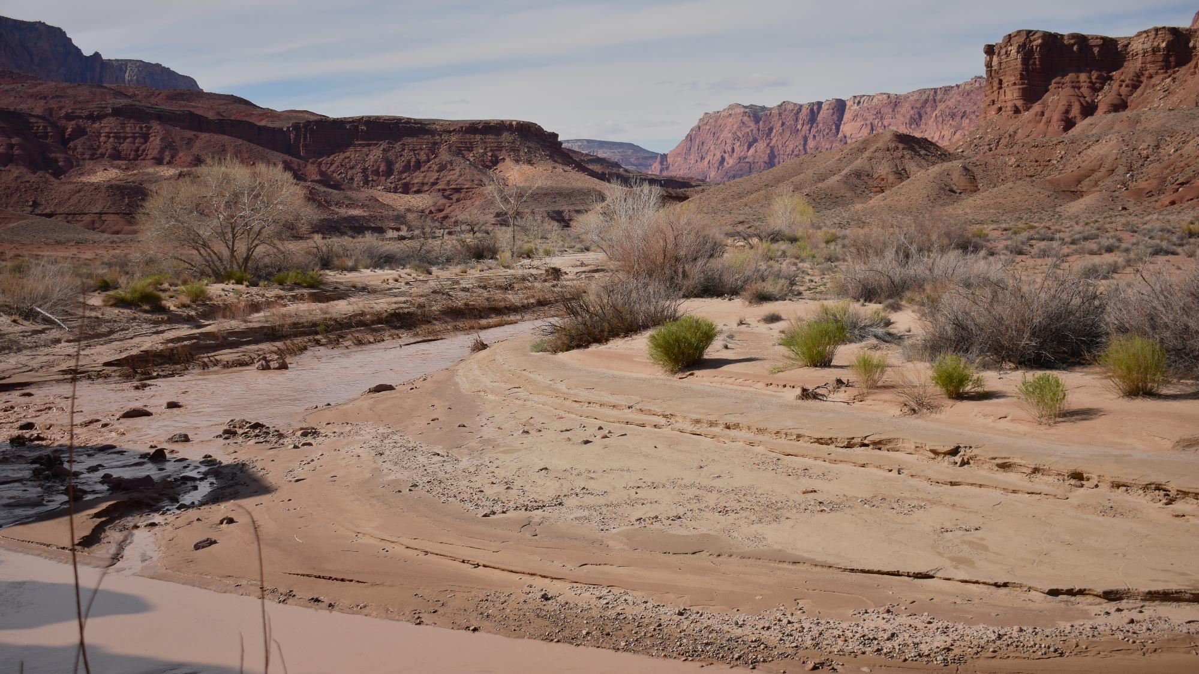



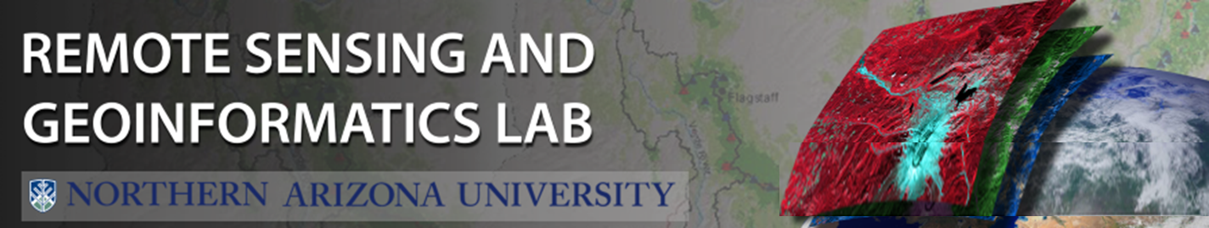
Remote Sensing of Vegetation and Geomorphic Changes along the Paria River
Anna Alfermann
Temuulen Sankey, Joel Sankey
Northern Arizona University
Arizona NASA Space Grant Statewide Student Research Symposium
April 22nd, 2023

Slide 2
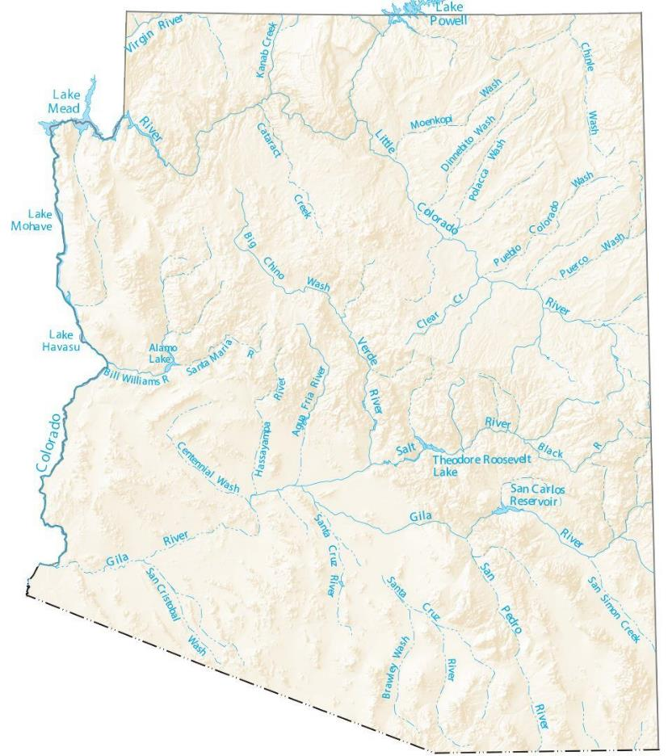



Introduction
The Paria River is a crucial tributary for the Colorado River
Riparian vegetation and geomorphology along the river are changing at a rapid rate due to flood and drought events
Image Courtesy of GISGeography gisgeography.com/arizona-lakes-rivers-map/
Notes:
Sensor used- ADS40 SH52 push-broom multispectral sensor
May 20 to 27,, 2009, May 25 to 30, 2013, and May DATE, 2021

Slide 3
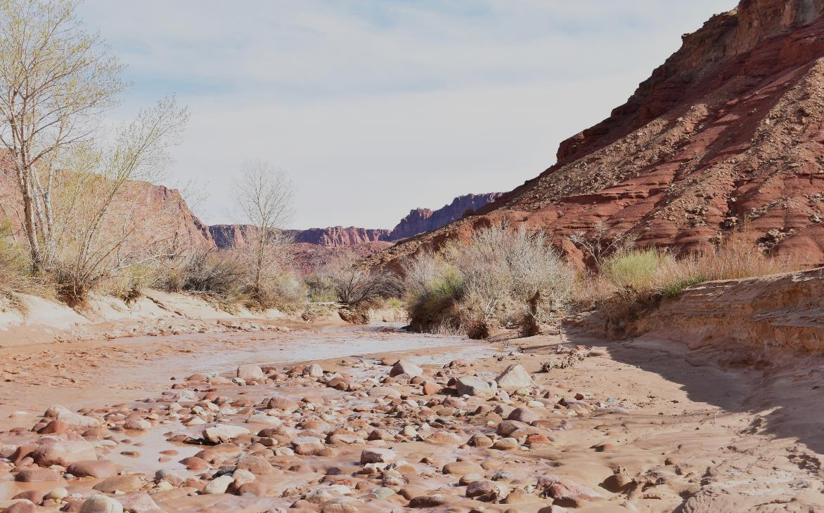
Research Objectives
Quantify vegetation and geomorphic changes along 11.75 km of the Paria River with ENVI software
Use multispectral aerial imagery collected on May 2009, May 2013, and May 2021

Slide 4
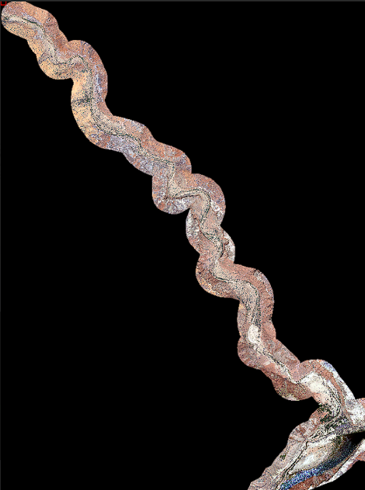
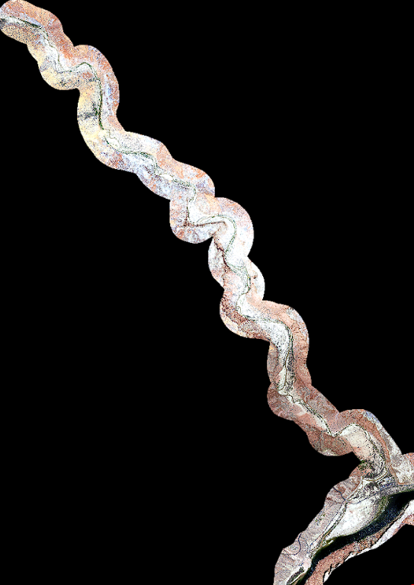
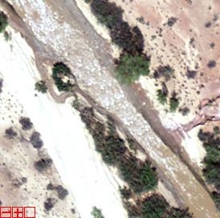
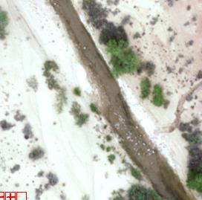



Methods: Image Preprocessing
Mosaic georeferenced files
Subset and resize
Confirm metadata
Notes:
Image details

Slide 5
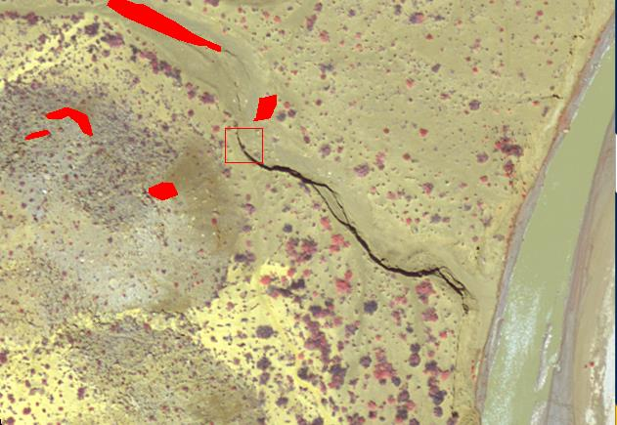
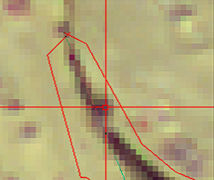


Methods: Masking
Regions of interest (ROIs)
Shadow and manmade class
Build and apply masks
Notes:
Image details: 2009 Image is being displayed with band 4 (nir) as red
Shadows were different in each year of imagery and the ROIs were adjusted for each year. For example; in the 2021 image I extended some of the ROIs because of the orientation of the sun was different.
The polygon multi point tool was used to identify and select shadows from the image. Then the ROIs were reconciled via maps to the binary class images.

Slide 6
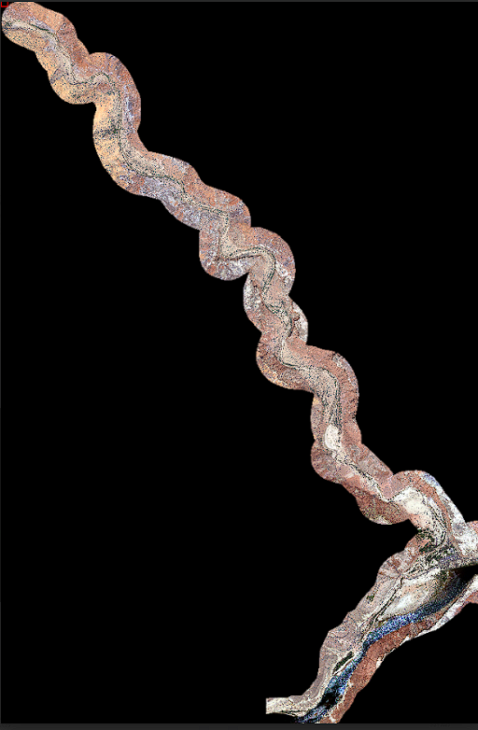
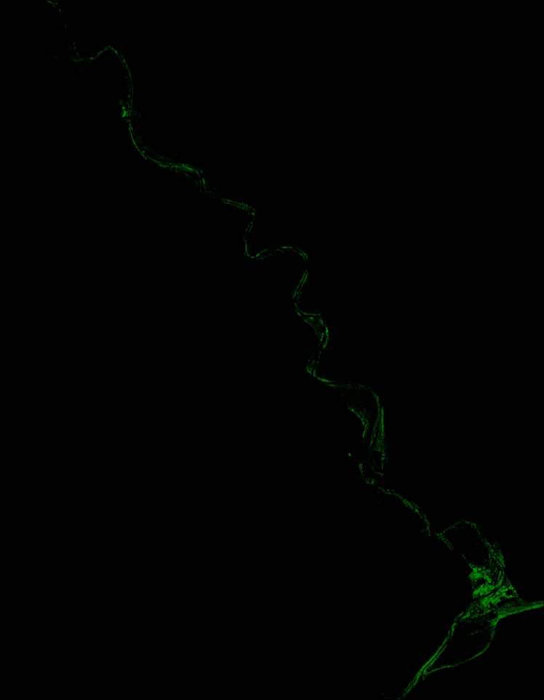
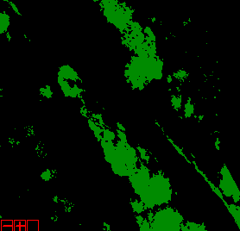
Total Vegetation Classification
Normalized Difference Vegetation Index
Machine Learning
Comparison of classifications
Notes:
2009 final mosaicked image and 2009 veg classification

Slide 7
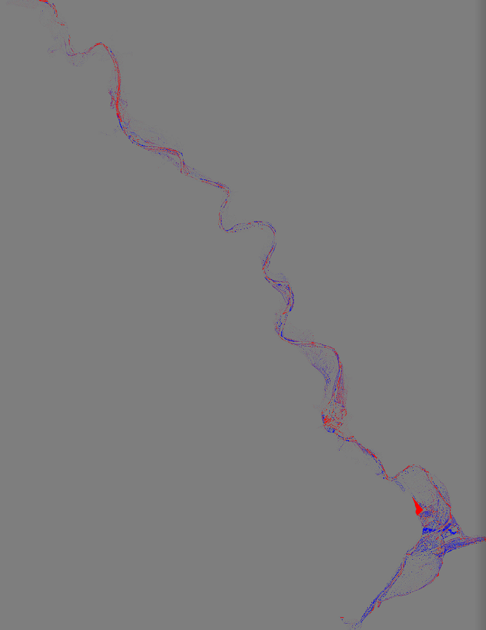
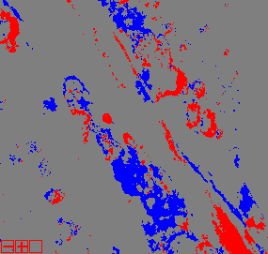


Results: Vegetation Change Detection
Vegetation changes from 2009 to 2021:
  Blue = veg. decline
  Red = veg. increase
Notes:
Zoomed in view**

Slide 8
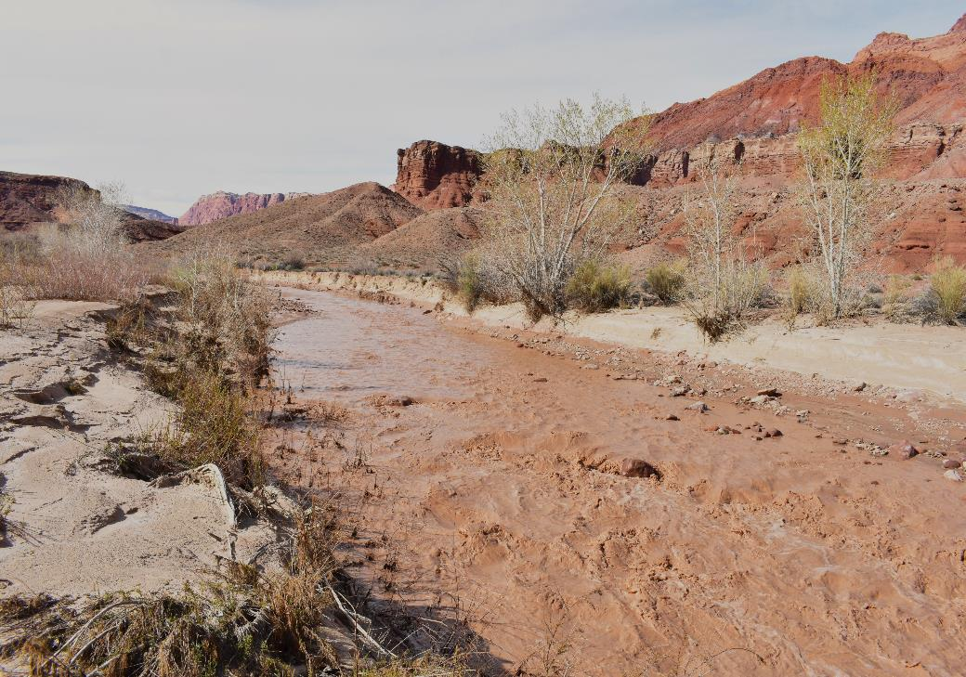


Change Detection Statistics
From 2009 to 2021:
Vegetation decreased 45%
Vegetation increased 0.3%
Notes:
Zoom change detection map*

Slide 9
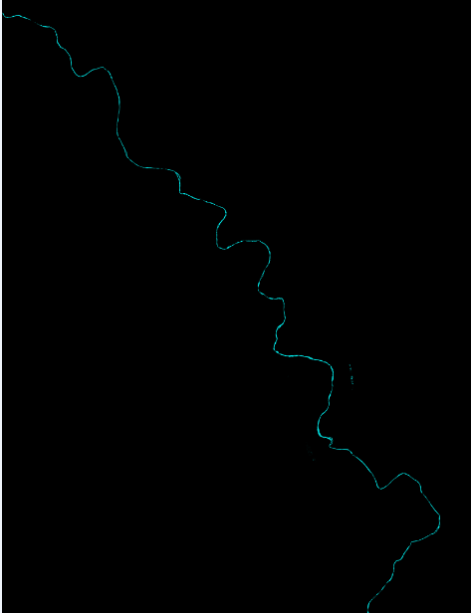

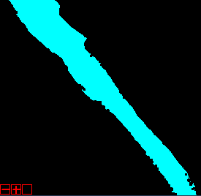
Total Water Classification
Green Normalized Difference Vegetation Index (GNDVI)
Post classification
Compare classifications

Slide 10
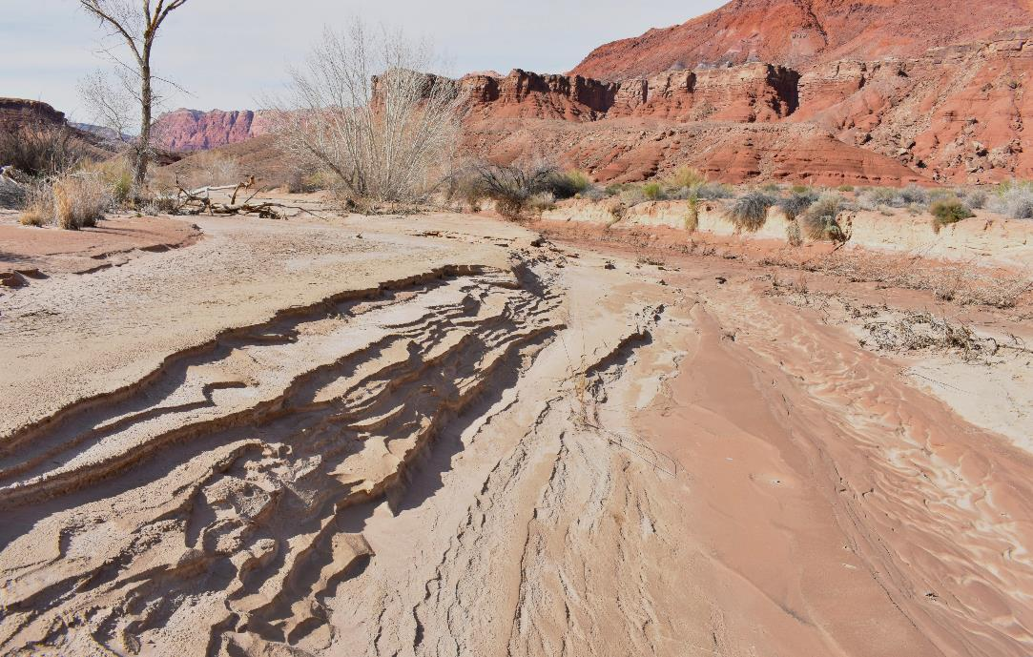


Change Detection Statistics
From 2009 to 2021:
Water decreased 79%
Water increased 0.06%
Notes:
Zoom change detection map*

Slide 11
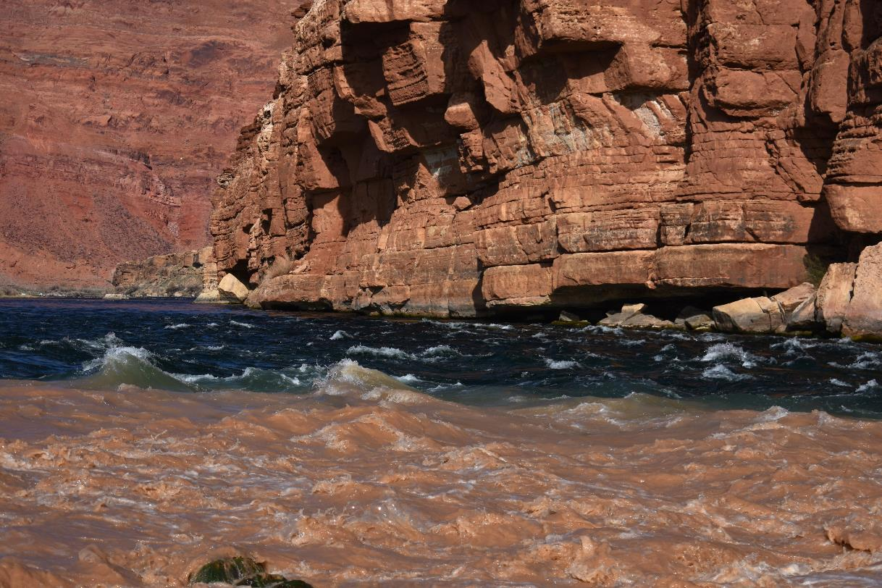



Summary
Vegetation has decreased up to 45% over the 12-year period.
The floodplain, sandbars, and meandering have changed substantially over time.
Water class has decreased 79% from 2009 to 2021.
Notes:
Vegetation and decrease in Tamarisk

Slide 12
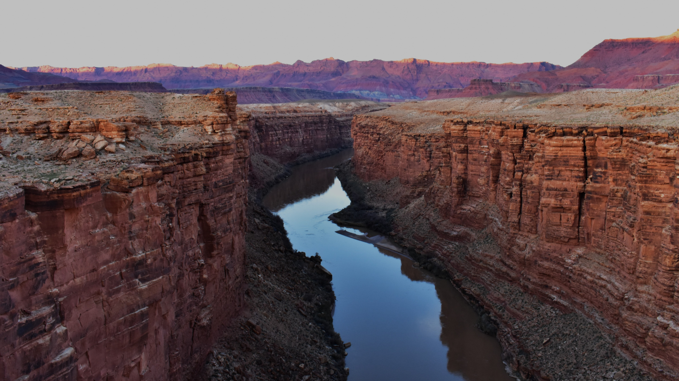

Acknowledgements
Temuulen Sankey
Joel Sankey
Nathaniel Bransky
Arizona Space Grant Consortium
USGS
Northern Arizona University

Slide 13
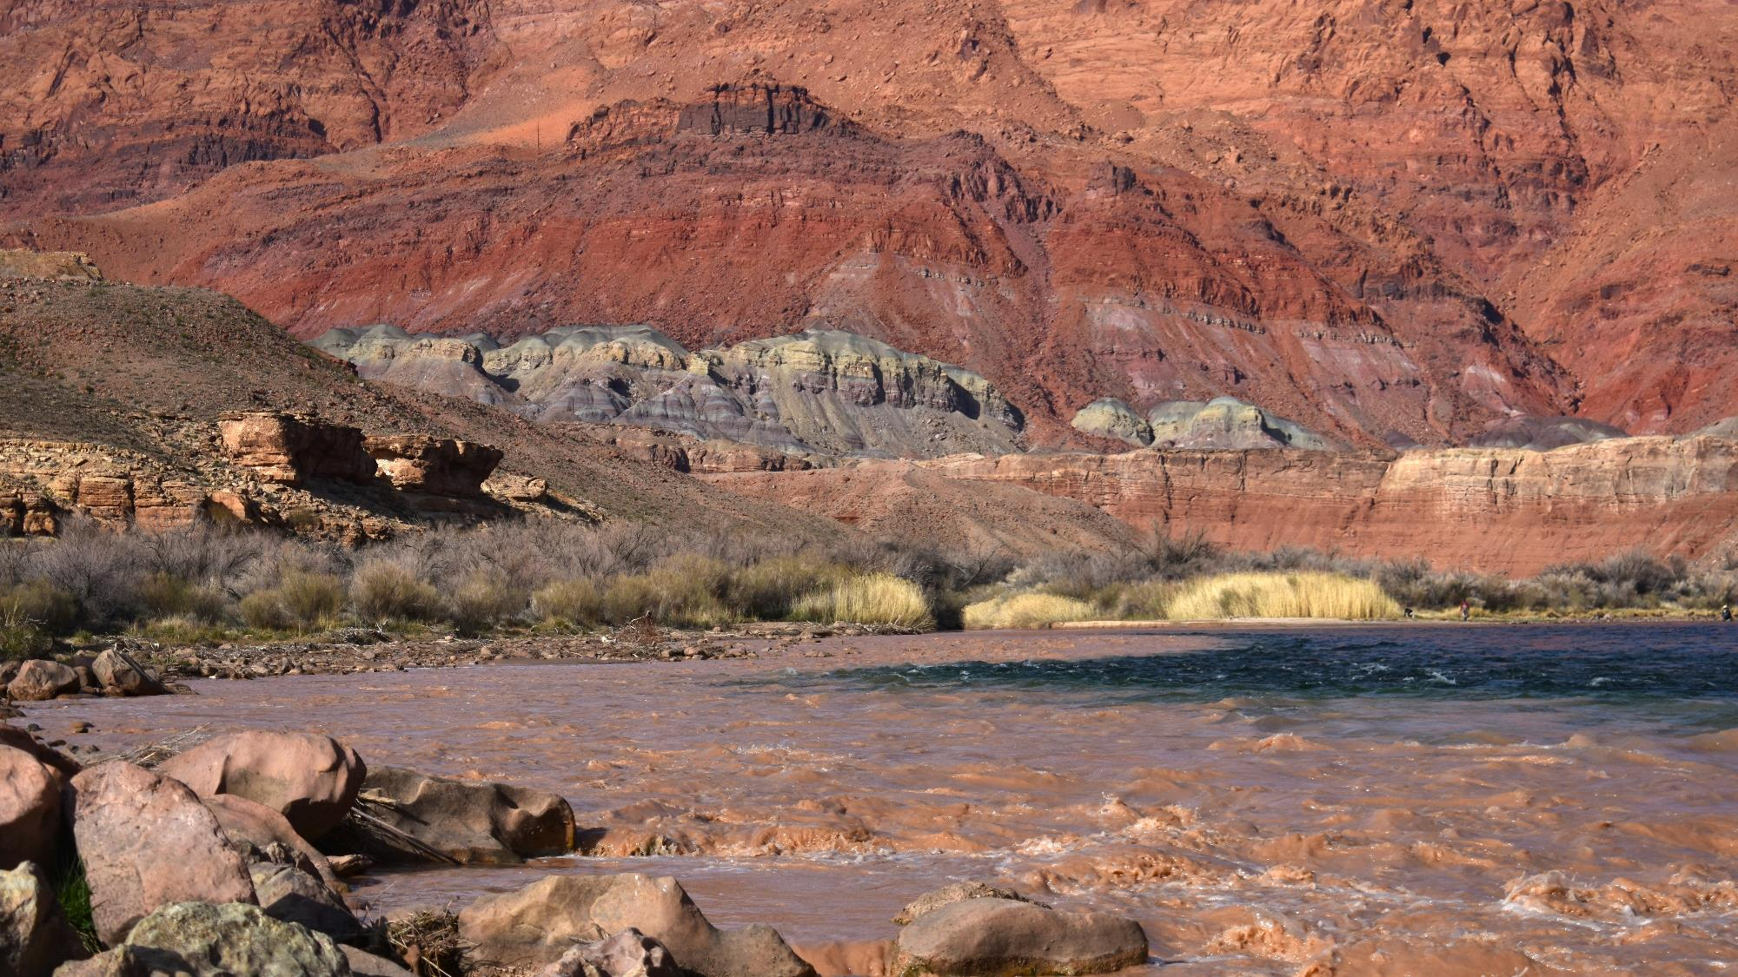
Thank you

